Slide 1
An Introduction to Android Fragments
How to create & handle fragments

Slide 2
Why to use fragments
Do you want your app to look and behave differently depending on whether it’s running on a phone or a tablet? Do you want your app to look good on both device orientations? Do you want to reduce the number of activities and have a quicker action?
If yes, you need fragments, modular code components that can be reused by different activities and reduce time.
In this session, you will learn
how to create basic fragments,
how to add them to your activities, and
how to get your fragments and activities to communicate with one another

Slide 3

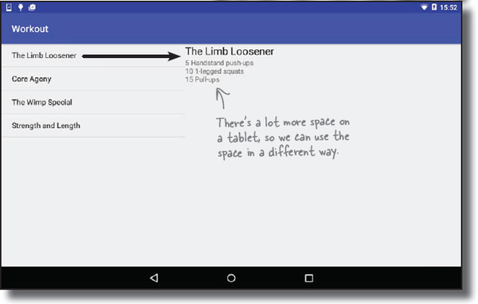
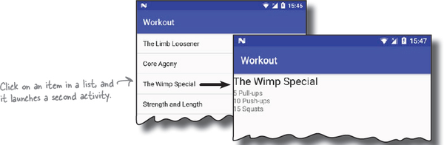
Your app needs to look great on ALL devices
On a phone
On a tablet

Slide 4
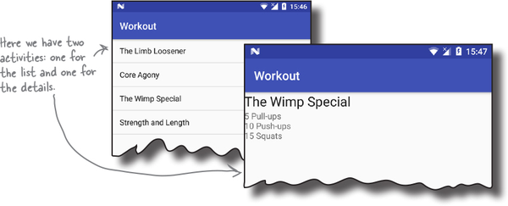
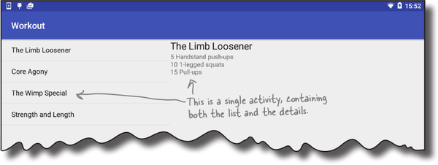
Your app may need to behave differently too
On a phone
On a tablet

Slide 5
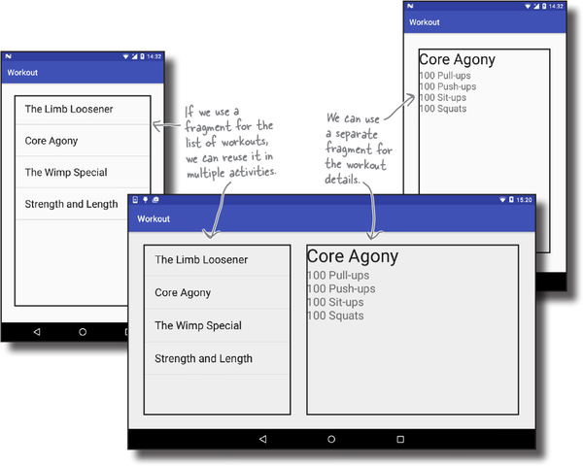
Fragments allow you to reuse code
Fragments are like reusable components or sub-activities
A fragment is used to control part of a screen, and can be reused between screens
This means we can create a fragment for the list of workouts, and a fragment to display the details of a single workout
These fragments can then be shared between layouts

Slide 6
More details
Fragments Are Still a Core UI Component
Fragments remain self-contained, modular sections of an app’s UI that can be embedded within an Activity or a Navigation Component.
Updated Consideration: With Jetpack Compose, developers now have an alternative UI framework that doesn’t use Fragments. However, XML-based UIs still heavily rely on Fragments.
Dynamic UI with Fragments
Fragments can be dynamically added, replaced, or removed at runtime, allowing for flexible and responsive UI designs.
Updated Consideration: The recommended way to manage Fragment transactions is now through AndroidX Navigation Component instead of manually handling Fragment transactions with FragmentManager.
Fragments Must Be Used Within an Activity
Fragments cannot exist independently; they must be hosted inside an Activity.
Updated Consideration: Fragments can now also be hosted inside another Fragment via Nested Fragments (using FragmentContainerView).

Slide 7
More details
Fragments as "Sub-Activities" with Their Own Lifecycle
Fragments have a lifecycle similar to Activities, but with some differences (e.g., they are dependent on the parent Activity's lifecycle).
Updated Consideration: The Fragment Lifecycle has evolved, and developers are encouraged to use ViewModel and Lifecycle-aware components to manage UI-related data efficiently.
Adding Fragments Using XML or Code
Fragments are defined in XML using FragmentContainerView and can also be added programmatically in Java/Kotlin.
Updated Consideration:Deprecated Approach: Directly using <fragment> in XML.Recommended Approach: Using FragmentContainerView for better lifecycle management.

Slide 8
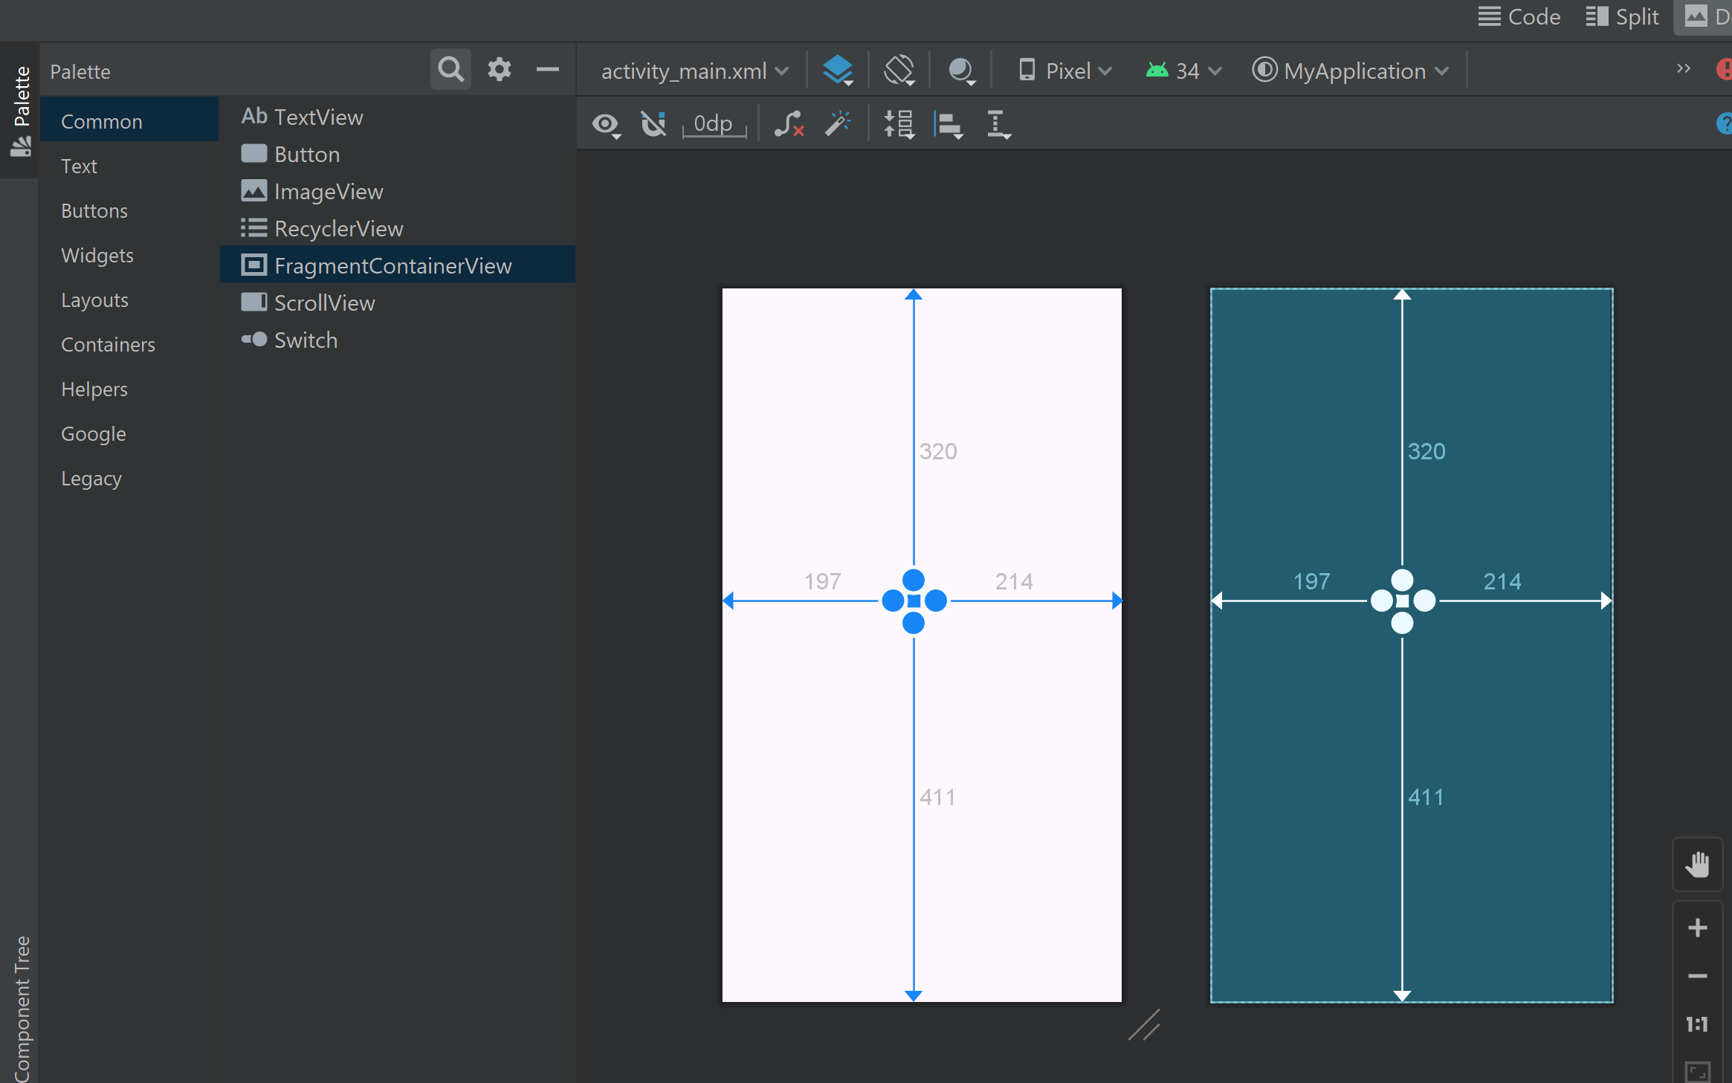
Adding a Fragment to an Activity using the Layout XML File
Use FragmentContainerView to add your Fragment to your activity
Note: You Need to add a fragment class first in order to use this UI element, go to File→New→Fragment→Fragment (blank)

Slide 9
Adding a Fragment to an Activity using the Layout XML File
XML Code Example
Java Code Example
<androidx.fragment.app.FragmentContainerView
android:id="@+id/fragment_container"
android:name="com.example.MyFragment"
android:layout_width="match_parent"
android:layout_height="match_parent" />
getSupportFragmentManager()
.beginTransaction()
.replace(R.id.fragment_container, new MyFragment())
.commit();

Slide 10
Adding a Fragment Dynamically (via code)
Steps to add a fragment to an activity using code:
1) Create an Instance of the Fragment
MyFragment fragment = new MyFragment();
2) Pass Arguments to the Fragment (Instead of using Intent)
Bundle args = new Bundle();
args.putString("key", "value");
fragment.setArguments(args);
3) Get the FragmentManager (Updated for AndroidX)
FragmentManager fragmentManager = getSupportFragmentManager();
4) Begin a Fragment Transaction
FragmentTransaction transaction = fragmentManager.beginTransaction();
5) Replace the Fragment transaction.replace(R.id.fragment_container, fragment);
6) Commit the Transaction
transaction.commit();
The ease of adding a fragment to an activity via the activity’s XML layout file comes at the cost of the activity not being able to remove the fragment at runtime
In order to achieve full dynamic control of fragments during runtime, those activities must be added via code
This has the advantage that the fragments can be added, removed and even made to replace one another dynamically while the application is running
When using code to manage fragments, the fragment itself will still consist of an XML layout file and a corresponding class

Slide 11
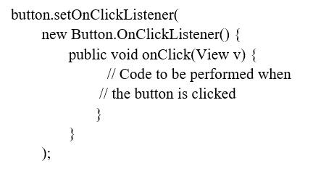
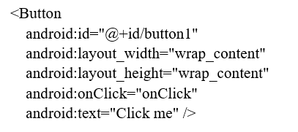
Handling Fragment Events
Java code:
A fragment is a modular UI component that has its own layout, class, and lifecycle, but it must be hosted within an Activity or another Fragment.
The view components (such as buttons and text views) within a fragment are able to generate events just like those in a regular activity
This raises the question as to which class receives an event from a view in a fragment; the fragment itself, or the activity in which the fragment is embedded
If the event only affects the fragment, handle it inside the fragment.
If the event affects both the fragment and activity, use a callback interface to pass the event to the activity.
XML file:

Slide 12
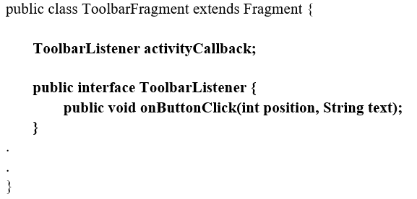
Implementing Fragment Communication
Once one or more fragments are embedded within an activity, the chances are good that some form of communication will need to take place both between the fragments and the activity, and between one fragment and another
In fact, good practice dictates that fragments do not communicate directly with one another
In order for an activity to communicate with a fragment, the activity must identify the fragment object via the ID assigned to it
Once this reference has been obtained, the activity can simply call the public methods of the fragment object
Communicating in the other direction (from fragment to activity) is a little more complicated
In the first instance, the fragment must define a listener interface, which is then implemented within the activity class

Slide 13
Fragment Communication Best Practices
Avoid Direct Fragment-to-Fragment Communication – Use an Activity or ViewModel as an intermediary.
Use ViewModel + LiveData (Recommended Approach) – Ensures decoupling, survives configuration changes, and improves state management.
Use FragmentResultListener (Simpler Alternative) – Eliminates the need for interfaces and works without Activity callbacks.
Use Interface Callbacks (Older Approach) – If ViewModel is not an option, define a listener interface inside the fragment and implement it in the activity.
Check If Fragment is Attached Before Calling Its Methods – Prevents crashes if the fragment is not displayed.

Slide 14
Summary
Fragments provide a powerful mechanism for creating re-usable modules of user interface layout and application behaviour, which, once created, can be embedded in activities.
A fragment consists of a user interface layout file and a class.
Fragments may be utilised in an activity either by adding the fragment to the activity’s layout file, or by writing code to manage the fragments at runtime.
Fragments added to an activity in code can be removed and replaced dynamically at runtime. All communication between fragments should be performed via the activity within which the fragments are embedded.

Slide 15

References and Further Readings
Android Developers Guide – Fragments https://developer.android.com/guide/fragments
Android Developers Guide – ViewModel & LiveData https://developer.android.com/topic/libraries/architecture/viewmodel
Android Developers Guide – Fragment Result API https://developer.android.com/reference/androidx/fragment/app/FragmentResultListener

Slide 16

Let’s understand how to use fragment by building a fragment project!

